Slide 1
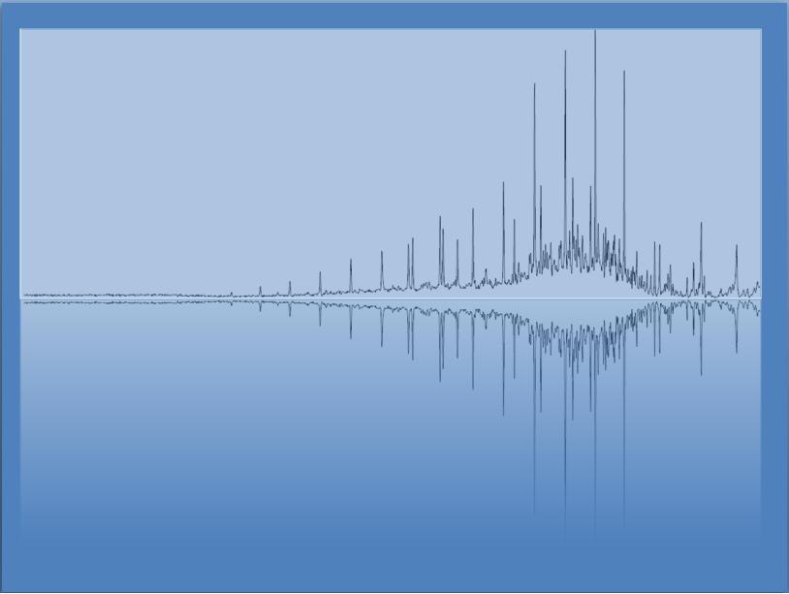
Oxidation and Reduction (RedOx)
Chem 3A- Yates

Slide 2
Outline
Reactions Experiment Questions (20 min)
RedOx / Determining Oxidation States
The Activity Series (Predicting if a reaction will happen.)

Slide 3
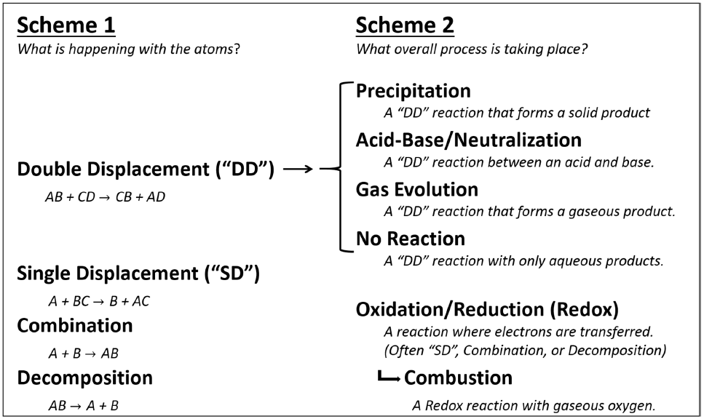
Chemical Reactions

Slide 4
RedOx -> Electron Transfers
Zn(s) + 2 HCl(aq) → H₂(g) + ZnCl₂(aq)
Zn⁰
H⁺
H⁰
Zn²⁺
Oxidation
States
+4
+3
+2
+1
0
-1
-2
-3
-4
Reduced (Element)
Oxidized (Element)
H⁺
↓
H⁰
Zn²⁺
↑
Zn⁰
Oxidizing (Reactant)
Agent
Reducing (Reactant)
Agent
Zn (s)
HCl (aq)

Slide 5
What about the combustion of butane?
CH₄(g) + 2 O₂(g) → CO₂(g) + 2 H₂O(g)
Oxidation
States
+4
+3
+2
+1
0
-1
-2
-3
-4
Reduced (Element)
Oxidized (Element)
Oxidizing (Reactant)
Agent
Reducing (Reactant)
Agent

Slide 6
Determining Oxidation States (pseudo charges)
If an ionic compound, separate ions.
Give the most EN element the “charge” it wants.
*If H is bonded to more EN element, start by giving it a +1
Solve for other element so that.
Neutral compounds = 0
Polyatomic Ions = charge

Slide 7
What about the combustion of butene?
CH₄(g) + 2 O₂(g) → CO₂(g) + 2 H₂O(g)
Oxidation
States
+4
+3
+2
+1
0
-1
-2
-3
-4
Reduced (Element)
Oxidized (Element)
O
C
Oxidizing (Reactant)
Agent
Reducing (Reactant)
Agent
CH₄
O₂(g)

Slide 8
Assign an Oxidation State to Each Element in the Following:
F₂
Mg²⁺
PO₄³⁻
Na₂SO₃

Slide 9
Assign an Oxidation State to Each Element in the Following,
F₂ F = 0
Mg²⁺ Mg = +2
KCl K = +1, Cl = -1
Na₂SO₃ Na = +1, S = +4, O = -2

Slide 10
Outline
Reactions Experiment Questions
RedOx / Determining Oxidation States
The Activity Series (Predicting if a reaction will happen.)

Slide 11
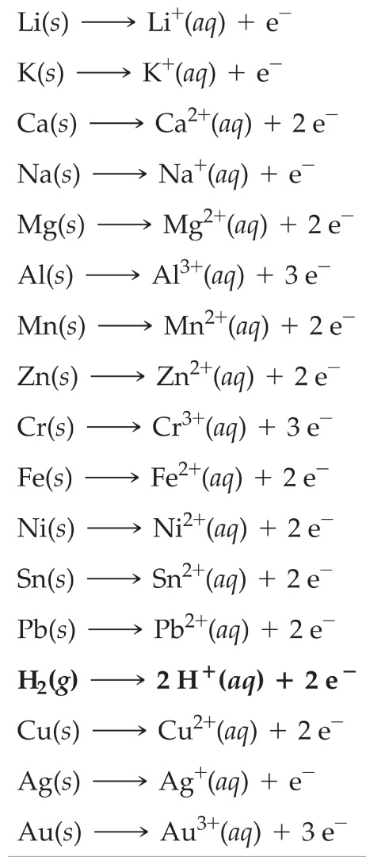
Activity Series Neutral Atoms Higher on the chart tend to give electrons to ions lower. *In other words, the lower element wants electrons most.
Determine if the following reactions will occur.
Cu(s) + NaCl (aq) →
Cu(s) + HCl (aq) →
Cu(s) + AgNO₃ (aq) →
Mg(s) + NaCl (aq) →
Mg(s) + HCl (aq) →

Slide 12
Activity Series Neutral Atoms Higher on the chart tend to give electrons to ions lower. *In other words, the lower element wants electrons most.
Determine if the following reactions will occur.
Cu(s) + NaCl (aq) → X
Cu(s) + HCl (aq) → X
Cu(s) + AgNO₃ (aq) → Ag (s) + Cu(NO₃)₂
Mg(s) + NaCl (aq) → X
Mg(s) + HCl (aq) → H₂ (g) + MgCl₂

